Slide 1
MODULE 2 – MECHANICAL OSCILLATIONS
Differential equation of a spring, mass and damper system and its solution

Slide 2
IDEAL SPRING AND MASS
Let us consider an ideal case of single spring and single mass system and it is assumed that there is no friction , no damping.. i.e there is nothing that oppose the motion of each component (spring and mass).
In reality, you cannot have this kind of ideal system.
However, it is customary to understand differential equation with example mainly because this would give you the most fundamental form of differential equations based on Newton's second law and a lot of real life examples are derived from this just by adding some realistic factors (e.g, damping , frictions , external forces etc).

Slide 3
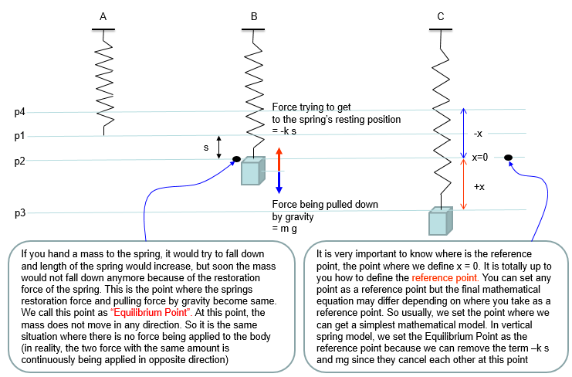

Slide 4
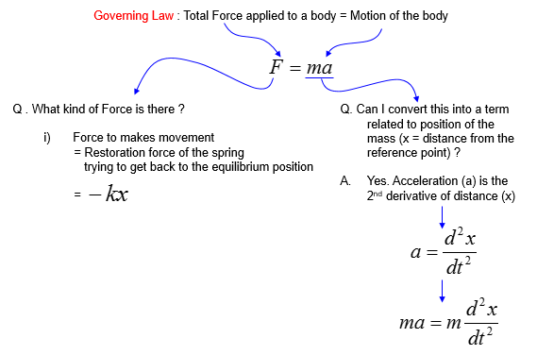
Based on the governing equation for this system, we would be able to list up all the component forces acting upon the system as shown below.

Slide 5
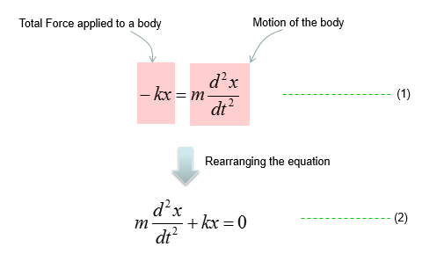
Combining these two parts you will get the equation as (1) and with a little bit of rearrangement you will get the equation as (2).

Slide 6
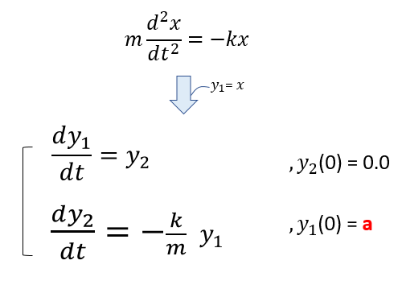
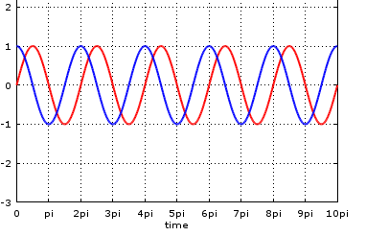
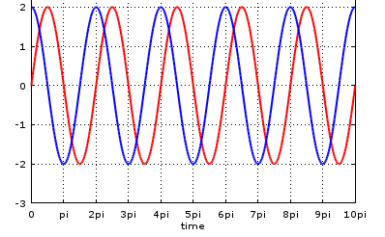
d²x/dt² +(k/m)x = 0
F = 1/2π(√k/m)
2πF = ω =√ k/m
d²x/dt² +ω² x=0
General solution to the 2nd order
differential equation is:
X (t) = A sin ωt + B cos ωt
What if ‘A’ increases?
Y1 =1, k=1, m=1
Y1 =2, k=1, m=1

Slide 7
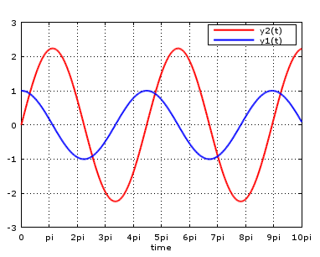
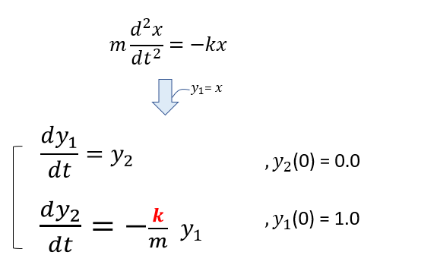
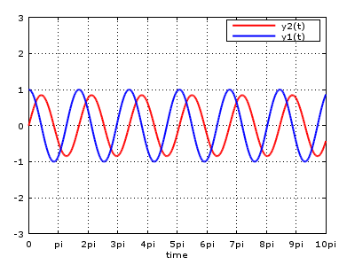
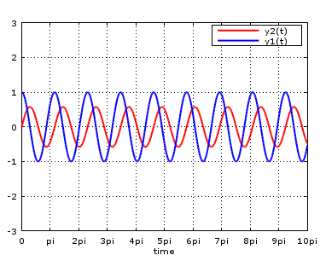
Y1 =1, k=0.2, m=1
What if k increases?
Y1 =1, k=1.4, m=1
Y1 =1, k=3, m=1

Slide 8
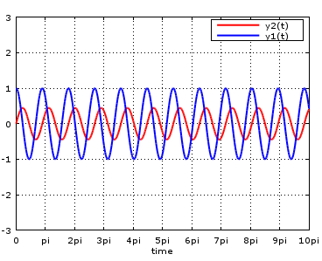
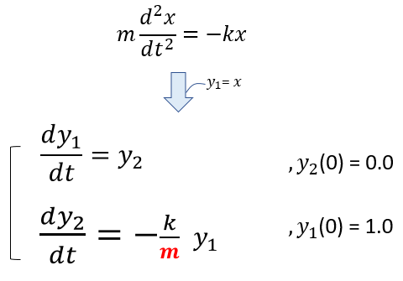
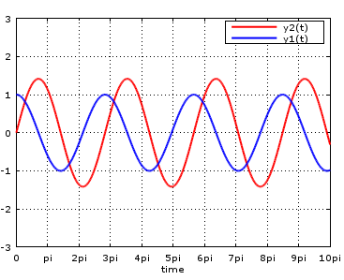
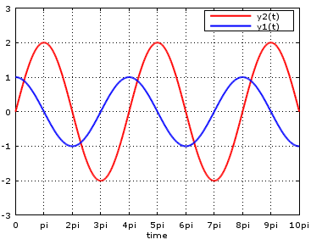
Y1 =1, k=1, m=0.2
Y1 =1, k=1, m=2
Y1 =1, k=1, m=4

Slide 9
SPRING MASS AND DAMPER
In real life spring, there is always some factors that is opposing the spring movement (contraction and expansion) as if there is always some kind of friction when you move any object(a mass) on a surface (e.g, table). This kind of opposing factor in the spring system is called Damping.
As you cannot completely remove the friction on a surface, you cannot completely remove this kind damping however hard you try. In some case (e.g, in shock absorbers in mortor bike or automotives), we physically add special components that increases this kind of damping.
So in real life modelling of a spring system, the first additional component to be added to the idea model would be a damper. Usually a damper is illustrated as shown below (looks like a very simple piston).

Slide 10
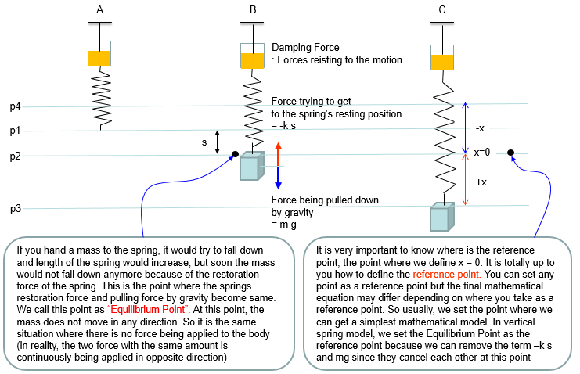

Slide 11
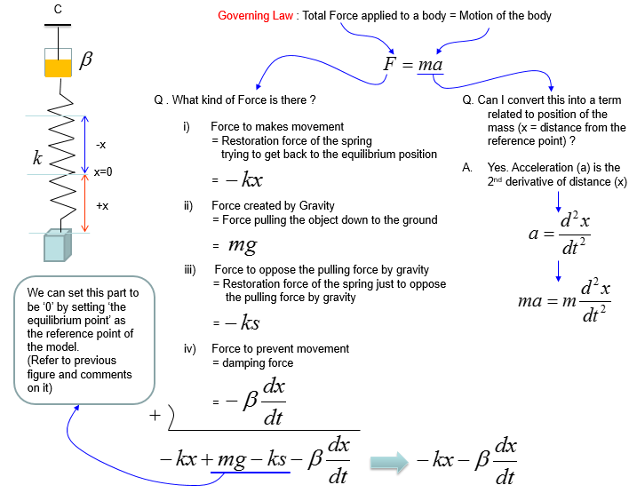
C
C
C

Slide 12
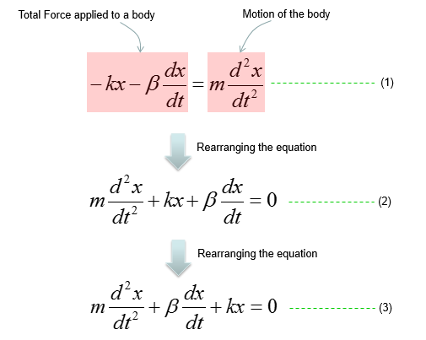
Combining these two parts we will get the equation as (1)
and with a little bit of rearrangement we will get the equation as (2)
C
C
C

Slide 13
In case of equation 3:
a = 1
b =c/m
c = k/m
Inline with the video, the second order differential equation (3) can be converted into a quadratic equation of the form:
λ²e^{λt} +b λe^{λt} + c e ^{λt} = 0 and the roots of this eqn is given by:
λ= (-c/2 m) ± √ (c²/4m² – k/m)
Based on c²/4m² –k/m values , the solution to the equation 3 are:
c²/4m² >> k/m ; c² >> 4km → x(t) = e ^{λ1t} + e^{λ2t}
c²/4m² = k/m ; c² =4km → x(t) = e ^{λt}
c²/4m² << k/m ; c² << 4km → x(t) =e^{λ1t} + e ^{λ2t}
Root of quadratic equation is x= (-b ±√b²-4ac)/2a

Slide 14
Taking up case 3:
General Solution to this equation of motion is:
X(t) = Ae^{-γt}cos(ω’t) [at t=0 x=A]
Only when the following conditions are satisfied
ω’ ≠ ω; and ω’ = √(k/m)- (c²/4m²)
γ = c/2m
And therefore:
X(t) = Ae^{-γt}cos(ω’t) becomes a solution for a lightly damped Harmonic Oscillator

Slide 15
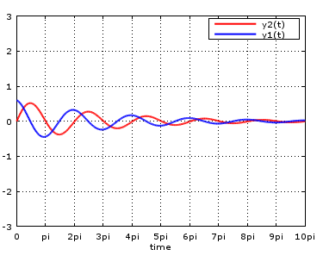
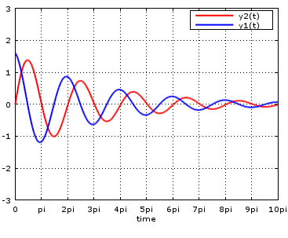
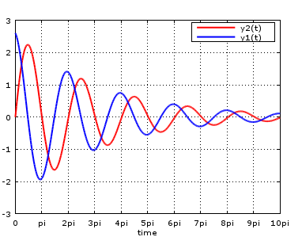
How the solution changes as the initial condition (initial displacement) changes ?
Y1 =0.6, k=1, m=1,c=0.2
Y1 =1.6, k=1, m=1,c=0.2
Y1 =2.6, k=1, m=1,c=0.2

Slide 16
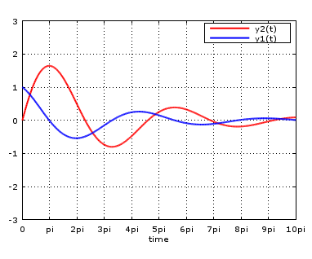
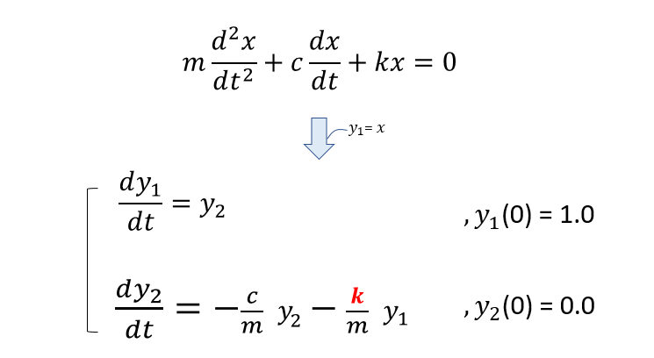
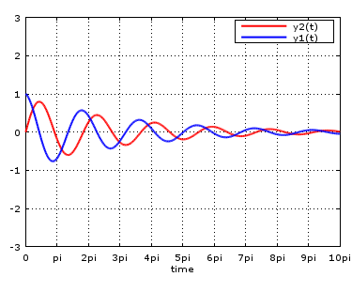
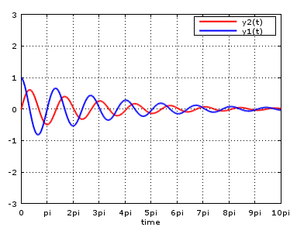
How the solution changes as k changes ?
Y1 =1, k=0.2, m=1,c=0.2
Y1 =1, k=1.2, m=1,c=0.2
Y1 =1, k=2.2, m=1,c=0.2

Slide 17
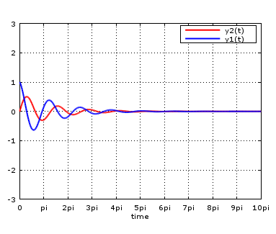
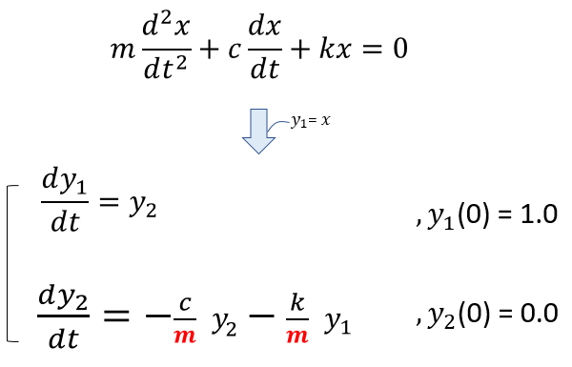
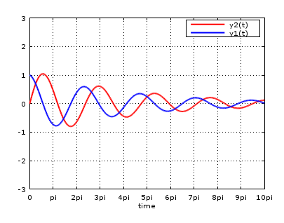
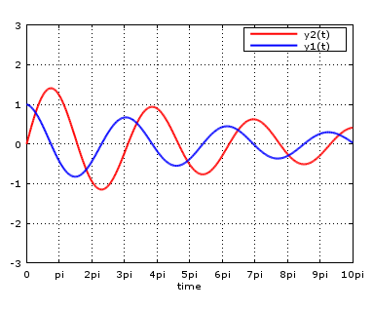
How the solution changes as m changes ?
Y1 =1, k=1, m=0.4,c=0.2
Y1 =1, k=1, m=1.4,c=0.2
Y1 =1, k=1, m=2.4,c=0.2

Slide 18
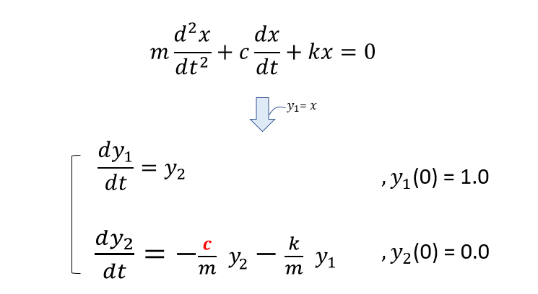
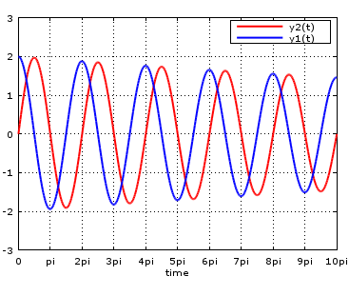
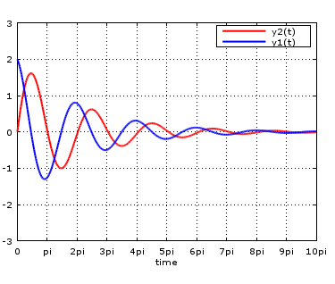
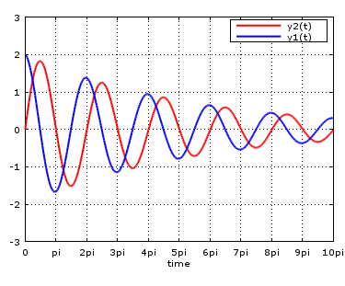
How the solution changes as c changes ?
Y1 =1, k=1, m=1,c=0.02
Y1 =1, k=1, m=1,c=0.30
Y1 =1, k=1, m=1,c=0.12

Slide 19
General Solution to this equation of motion is:
X(t) = Ae^{-γt}cos(ω’t) [at t=0 x=A]
Only when the following conditions are satisfied
ω’ ≠ ω; and ω’ = √(k/m)- (c²/4m²)
= c/2m
Based on values of k/m and c²/4m² three conditions are specified:i.e
k/m << c²/4m^{2 ;} c²>>4mk-----over damped
k/m >>c²/4m^{2 ;} c²<<4mk----- under damped
k/m =c²/4m^{2 ;} c²=4mk ------ critically damped

Slide 20
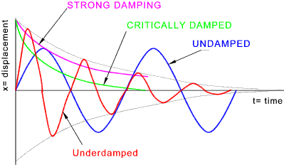

Slide 21
Critical damping is when the system returns to its equilibrium position in the shortest possible time without any oscillation.
Examples:
1.Instruments such as speedometers are critically damped so when a car accelerates, the speedometer quickly changes and it doesn’t oscillate and confuse the driver.
2. The shock absorbers on a car critically damp the suspension of the vehicle and so resist the setting up of vibration which could make control difficult or cause damage.
Heavy damping:
The system returns to the equilibrium position very slowly, without any oscillation. Heavy damping occurs when the resistive forces exceed those of critical damping.
Example:
1. A door hamper. How slowly the door swings shut without any oscillation depends on how strong the damper is. In most cases, the damper used on a door is a heavy damper, and it slowly closes the door with no oscillation (meaning the door doesn’t swing back and forth).

Slide 22
Light damping:
Defined oscillations are observed, but the amplitude of oscillation is reduced gradually with time.
Example:
Imagine that same door but with a light damper. The light damper will allow the door to swing back and forth, the swing decreasing in momentum until the door slowly comes to a stop.
References:
http://www.sharetechnote.com/html/DE_Modeling_Example_SpringMass.html
https://youtu.be/V9bl02Ffo_o
https://youtu.be/qxDvW8_fm7I
https://youtu.be/H6wAgtvX_8w

Slide 23
Appendix:
Every quadratic equation gives two values of the unknown variable and these values are called roots of the equation.
Let ax² + bx + c = 0 be a quadratic equation. If aα² + bα + c = 0 then α is called a root of
the quadratic equation ax²+ bx + c = 0. Thus,
α is a root of ax² + bx + c = 0 if and only if aα² + bα + c = 0
If aα² + bα + c = 0 then we say x = α satisfies the equation ax² + bx + c = 0 and x = α is a solution.
Thus, every solution is root.
A quadratic equation has two roots which may be (i) unequal real numbers (ii) equal real numbers, or(iii) numbers which are not real.
If a quadratic equation has two real equal roots α, we say the equation has only one real solution.

Slide 24
Resonance
The natural frequency is the frequency at which a system would oscillate if there were no driving and no damping force.
The phenomenon of driving a system with a frequency equal to its natural frequency is called resonance. A system being driven at its natural frequency is said to resonate. As the driving frequency gets progressively higher than the resonant or natural frequency, the amplitude of the oscillations becomes smaller until the oscillations nearly disappear
At higher and lower driving frequencies, energy is transferred to the system less efficiently, and it responds with lower-amplitude oscillations.

Slide 25
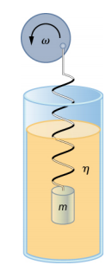
Effect of driving force on spring mass and damper system
Consider a mass m attached to a spring in a viscous fluid which acts as a damper. Attach the other free end to a disk that is driven by a variable-speed motor.
The motor turns with an angular driving frequency of ω . The rotating disk provides energy to the system by the work done by the driving force (F_{d} = F₀ sin(ωt)).
Using Newton’s second law (F⃗ _{net}=ma⃗ ), we can analyze the motion of the mass.
The resulting equation is similar to the force equation for the damped harmonic oscillator, with the addition of the driving force:

Slide 26
−kx−c(dx/dt)+F₀sin(ωt)=m(d²x/dt²) --------(1)
When an oscillator is forced with a periodic driving force, the motion may seem chaotic. The motions of the oscillator is known as transients. After the transients die out, the oscillator reaches a steady state, where the motion is periodic. After some time, the steady state solution to this differential equation is
x(t)=Acos(ωt+ϕ). ------------------(2)
Taking the first and second time derivative of x(t) and substituting them into the force equation shows that x(t) = Acos(ωt+ϕ) is a solution as long as the amplitude is equal to
A=F₀/ (√m²(ω²−ω₀²)²+c²ω²)−−−−−(3)
where ω₀=√k/m is the natural angular frequency of the system of the mass and spring.

Slide 27
Recall that the angular frequency, and therefore the frequency, of the motor can be adjusted.
Looking at the denominator of the equation for the amplitude, when the driving frequency is much smaller, or much larger, than the natural frequency, the square of the difference of the two angular frequencies (ω²−ω₀²)² is positive and large, making the denominator large, and the result is a small amplitude for the oscillations of the mass.
As the frequency of the driving force approaches the natural frequency of the system, the denominator becomes small and the amplitude of the oscillations becomes large.
The maximum amplitude results when the frequency of the driving force equals the natural frequency of the system (A_{max} = F₀/cω).

Slide 28
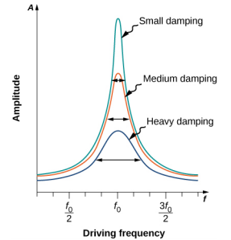
Influence of damping
The graph shows the amplitude of a damped harmonic oscillator as a function of the frequency of the periodic force driving it.
Each of the three curves on the graph represents a different amount of damping.
All three curves peak at the point where the frequency of the driving force equals the natural frequency of the harmonic oscillator.
The highest peak, or greatest response, is for the least amount of damping, because less energy is removed by the damping force.
Note that since the amplitude grows as the damping decreases, taking this to the limit where there is no damping (c = 0), the amplitude becomes infinite.

Slide 29
Width of the curve.........
It is interesting to note that the widths of the resonance curves shown in Figure depend on damping: the less the damping, the narrower the resonance.
The consequence is that if you want a driven oscillator to resonate at a very specific frequency, you need as little damping as possible.
For instance, a radio has a circuit that is used to choose a particular radio station. In this case, the forced damped oscillator consists of a resistor, capacitor, and inductor.
The circuit is “tuned” to pick a particular radio station. Here it is desirable to have the resonance curve be very narrow, to pick out the exact frequency of the radio station chosen.

Slide 30
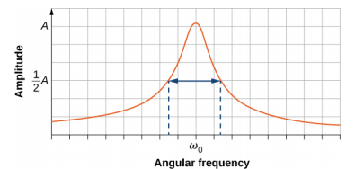
The narrowness of the graph, and the ability to pick out a certain frequency, is known as the quality of the system. The quality is defined as the spread of the angular frequency, or equivalently, the spread in the frequency, at half the maximum amplitude, divided by the natural frequency (Q = Δω/ω₀)
As shown in Figure for a small damping, the quality is approximately equal to Q ≈ 2c/m .

Slide 31
These features of driven harmonic oscillators apply to a huge variety of systems.
For instance, magnetic resonance imaging (MRI) is a widely used medical diagnostic tool in which atomic nuclei (mostly hydrogen nuclei or protons) are made to resonate by incoming radio waves (on the order of 100 MHz). In all of these cases, the efficiency of energy transfer from the driving force into the oscillator is best at resonance.
Reference:
Contributors and Attributions
Samuel J. Ling (Truman State University), Jeff Sanny (Loyola Marymount University), and Bill Moebs with many contributing authors.
Creative Commons Attribution License (by 4.0).

